Slide 1
口语 IA

Slide 2
The individual oral consists of a conversation with the teacher based on a visual stimulus and at least one additional course theme.

Slide 3
When carrying out the individual oral assessment, students may not bring into the preparation room any additional resources such as computers, mobile phones, class notes, dictionaries (either online or paper), copies of texts, and so on.

Slide 4
Schools must provide students with a piece of paper on which to make brief working notes (approximately 10 bullet points) during the 15 minutes of preparation time. These notes are the only resource that may be brought into the interview room; they are for reference only and must be retained by the teacher at the end of the interview.

Slide 5
It is essential that language ab initio students do not have prior knowledge of the visual stimulus to be presented, nor can they know in advance which of the themes the teacher will use for the general conversation in part 3.

Slide 6
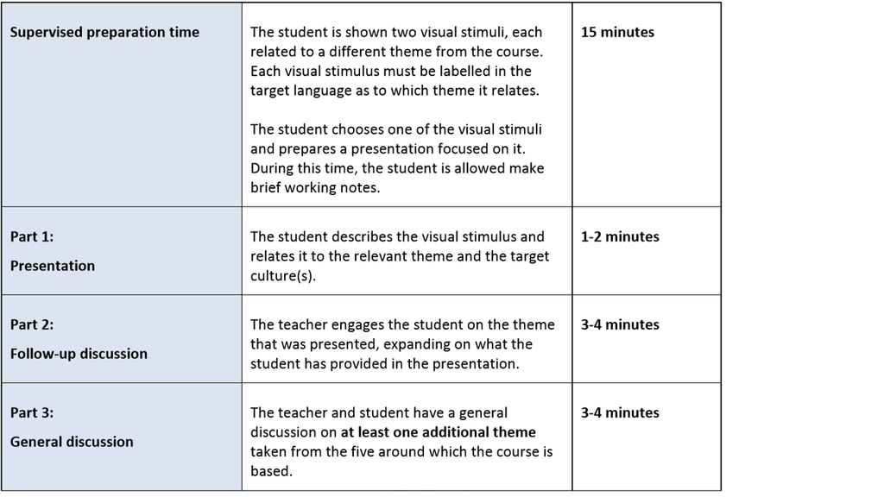

Slide 7
The presentation in part 1 must be wholly the work of the student and it must not be written out in full and read aloud. Authenticity may be checked by scrutiny of the notes (if any) used by the student, as well as through the follow-up questions in part 2 of the individual oral.

Slide 8
Choosing Visual stimuli 图片的选择

Slide 9
The teacher selects a range of visual stimuli linked to the five themes studied during the course and labels each in the target language according to theme.

Slide 10
For the purposes of the ab initio individual oral, a “visual stimulus” may be a photo, a poster, an illustration or an advertisement.

Slide 11
Any language that naturally appears on the image should be minimal and must be in the target language. It must not provide vocabulary or structures that would give a student an unfair advantage.

Slide 12
Effective visual stimuli

Slide 13
• Are clearly relevant to one of the five themes in the course
• Are culturally relevant to the target language
• Offer opportunities for students to demonstrate their international-mindedness
• Offer sufficient visual text for students to describe a scene or situation

Slide 14
•Allow the student to offer a personal interpretation
• Enable the teacher to lead the student in a wider conversation
• Are relevant and of interest to the student’s age group

Slide 15
The same five stimuli, one from from each of the themes, selected randomly, can be used for up to ten students sitting the exam. If there are more than ten students sitting the examination, two visual stimuli from each theme must be prepared.

Slide 16
Selection of visual stimuli
The teacher selects a range of visual stimuli linked to the five themes studied during the course and labels each in the target language according to theme. For the purposes of the ab initio individual oral, a “visual stimulus” may be a photo, a poster, an illustration or an advertisement.
Note: The same five stimuli can be used for up to ten students sitting the exam. If there are more than ten students sitting the examination, two visual stimuli from each theme must be prepared.

Slide 17
What is a good image?
A good visual stimulus:
is clearly relevant to one of the five themes in the course
is culturally relevant to the target language
offers opportunities for students to demonstrate their international-mindedness
offers sufficient visual text for students to describe a scene or situation
allows the student to offer a personal interpretation
enables the teacher to lead the student in a wider conversation
is relevant and of interest to the student’s age group.

Slide 18
选择的图片一定有好色彩缤纷一些，让学生有的说
一定要跟中国文化有关，让学生一目了然，否则会在B2失去分数
可以选卡通，但是尽量避免
不建议选择一张图片上有一系列图片，这样让学生无从下手
同样的图片，可以用在不同的theme，让学生可以多点选择

Slide 19
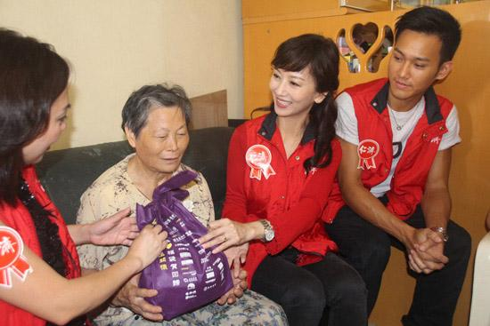
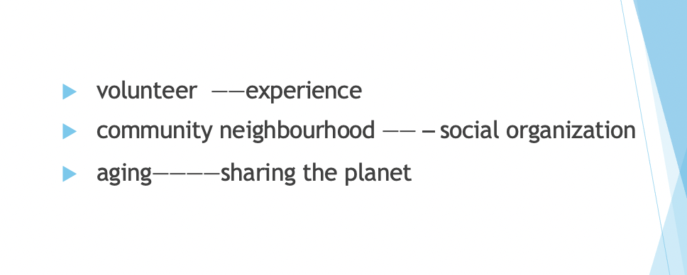
跟哪个theme有关？

Slide 20
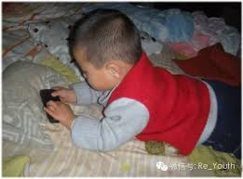
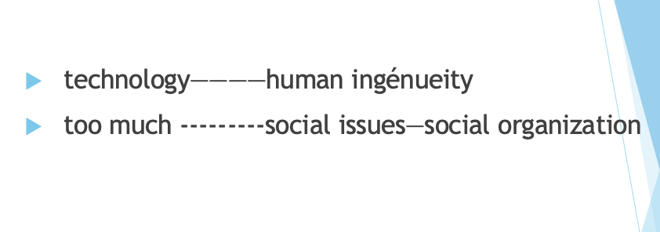

Slide 21
Conduct of IA

Slide 22
The internal assessment is to be conducted entirely in the target language.

Slide 23
The timing of the 15-minute preparation period begins when the student is presented with clean copies of each of the two stimuli (from two different themes). From these the student chooses one stimulus they would like to use for the individual oral.

Slide 24
Students are asked to avoid using their names or any other identifying information in their presentations.

Slide 25
The individual oral should last 7–10 minutes. Note: after 10 minutes the oral will no longer be assessed.

Slide 26
It should be based on the course themes: identities, experiences, human ingenuity, social organization, sharing the planet.

Slide 27
The role of teacher

Slide 28
• Seek clarification or extension of observations made by the student in the presentation.

Slide 29
• Invite the student to respond to ideas presented by both the visual stimulus and the teacher.

Slide 30
• Encourage connections and comparisons with the student’s other cultural experiences.

Slide 31
• Provide the student with opportunities to demonstrate his or her understanding and appreciation of the target language culture(s).

Slide 32
• Encourage the student to engage in authentic conversation to the best of his or her ability.

Slide 33
IA Criteria

Slide 34
The criteria used currently for assessing the individual oral have been modified for the new ab initio course.
There are now four criteria:
Criterion A Language
Criterion B1 Message: visual stimulus
Criterion B2 Message: conversation
Criterion C Communication

Slide 35
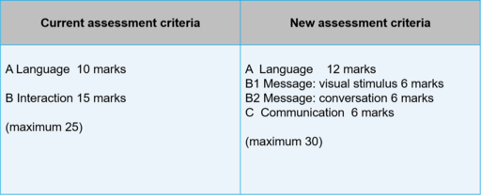

Slide 36
the emphasis in the new course on relating oral topics to the five themes

Slide 37
A LANGUAGE

Slide 38
To what extent is the vocabulary appropriate and varied?
• To what extent are the grammatical structures varied?
• To what extent does the accuracy of the language contribute to effective communication?
• To what extent do pronunciation and intonation affect communication?
WHAT DOES IT MEAN IN TEACHING?

Slide 39
B1 B1: Message—visual stimulus

Slide 40
How well does the candidate engage with the stimulus in the presentation?
How well are the ideas linked to the target culture(s)?

Slide 42
Criterion B2: Message—conversation

Slide 43
• How appropriately and thoroughly does the candidate respond to the questions in the conversation?
• To what depth are the questions answered?

Slide 44
Criterion C: Interactive skills—communication

Slide 45
• How well can the candidate express ideas?
• How well can the candidate maintain a conversation?

Slide 46
Sample Marking

Slide 47
Comments

Slide 48
Reflection time
3-2-1
Notes:
3 things you did not know before
2 things that you will try
1 thing you need more support/time/

Slide 49
千万要重视口语考试
校内评估
这是我们唯一可以在保持专业精神下尽可能帮助学生的部分

Slide 50
口语教学和考试应该注意的
多练
建立问题库
WA问题要提早准备
口试˙要说的过程描述语言要让学生多练。比如我们现在谈一谈另外一个话题
图片选择很有技巧
老师问问题的技巧
听力练习绝对不可以少， 听说一体，《爱汉语》里有专门的听力练习和模拟

Slide 51
问问题的大忌讳
第一个问题就是难题
不给学生足够的时间去process就开始重复或者换个词汇问问题
帮学生说， 总结学生说的， 纠正学生说的
故意谈笑风生
不好的面部表情和肢体语言
不给学生机会去展示自己
老师做主角

Slide 52
评分的时候注意
不要太乐观， 也不要太悲观
看整体表现，不要过分扣学生的错
严格按着大纲上的评分标准去给分

